Slide 1
Adidas US Business Stakeholders
Sales & Financial Performance Overview (January 2020 - December 2021)
BY keshav kumar

Slide 2
About Dataset
An Adidas sales dataset is a collection of data that includes information on the sales of Adidas products. This type of dataset may include details such as the number of units sold, the total sales revenue, the location of the sales, the type of product sold, and any other relevant information.
Adidas sales data can be useful for a variety of purposes, such as analyzing sales trends, identifying successful products or marketing campaigns, and developing strategies for future sales. It can also be used to compare Adidas sales to those of competitors, or to analyze the effectiveness of different marketing or sales channels.
There are a variety of sources that could potentially provide an Adidas sales dataset, including Adidas itself, market research firms, government agencies, or other organizations that track sales data. The specific data points included in an Adidas sales dataset may vary depending on the source and the purpose for which it is being used.

Slide 3
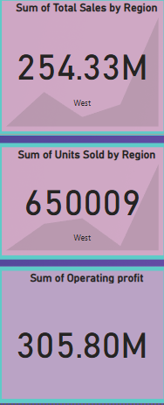
Key Metrics Overview
Total Sales by Region: $237.13M (West leads)
Units Sold: 607,808 units (West region)
Total Operating Profit: $293.55M
Average Price per Unit: $386.61K

Slide 4
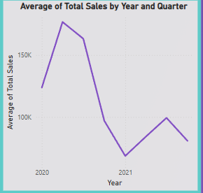
Sales Trend Analysis
Average Total Sales by Year & Quarter:
Sales peaked in 2020 and declined in 2021.
Some recovery observed in late 2021.

Slide 5
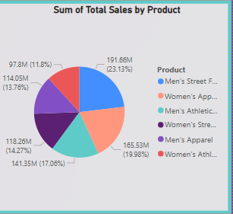
Product Performance
Total Sales by Product Category
Top-Selling Product: Men’s Street Footwear ($183.77M – 23.15%)
Other Key Categories:
Women’s Apparel: $159.37M (20.08%)
Men’s Athletic Footwear: $134.68M (16.97%)
Women’s Street Footwear: $113.1M (14.25%)
Men’s Apparel: $109.24M (13.76%)
Women’s Athletic Footwear: $93.63M (11.79%)

Slide 6
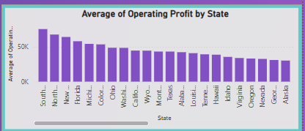
Operating Profit by State
Top Performing States:
South Dakota
Vermont
North Dakota
Montana
Consistent profit spread across many states, supporting nationwide demand.

Slide 7
Strategic Insights
Focus marketing and inventory on West region due to high sales and units sold.
Men’s Street Footwear is the top-selling product—strategize promotions accordingly.
Maintain strong relations with top-performing retailers.
Monitor states with lower average operating profits for improvement opportunities.

Slide 8
Recommendations
Expand high-performing product lines in top regions.
Investigate causes for sales dip in 2021 and address them.
Leverage top states to pilot new products or marketing campaigns.

